Slide 1
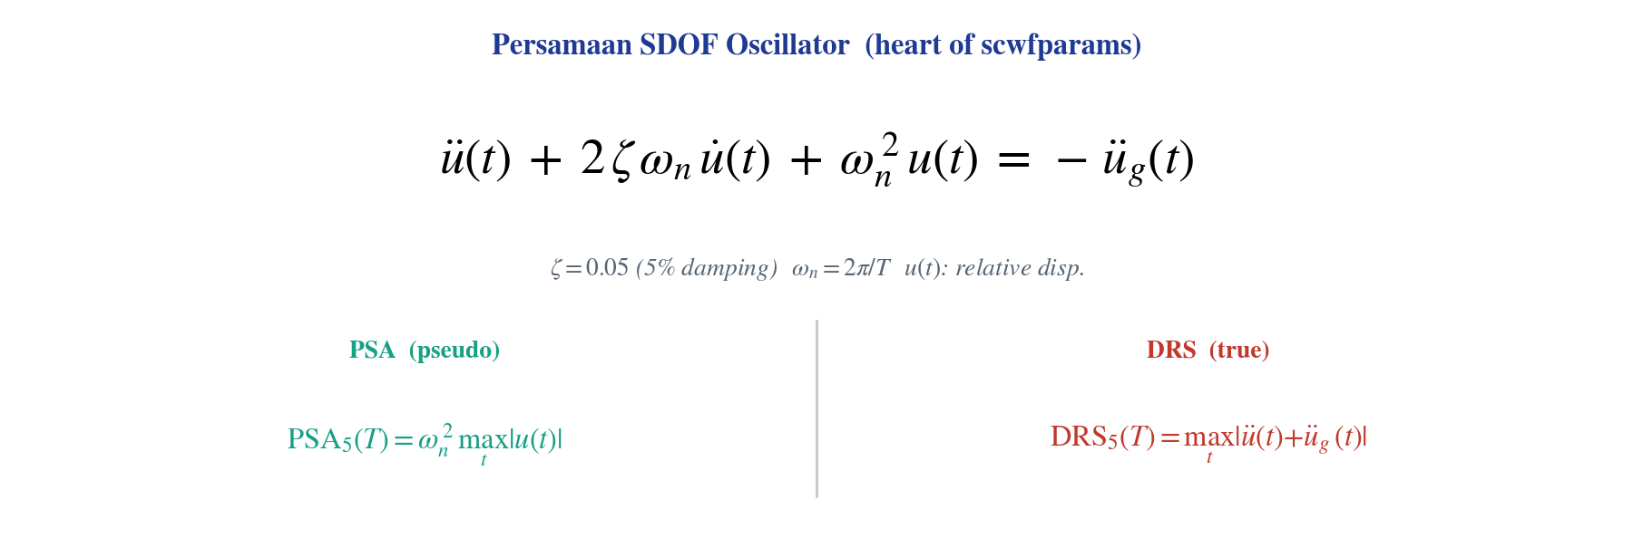
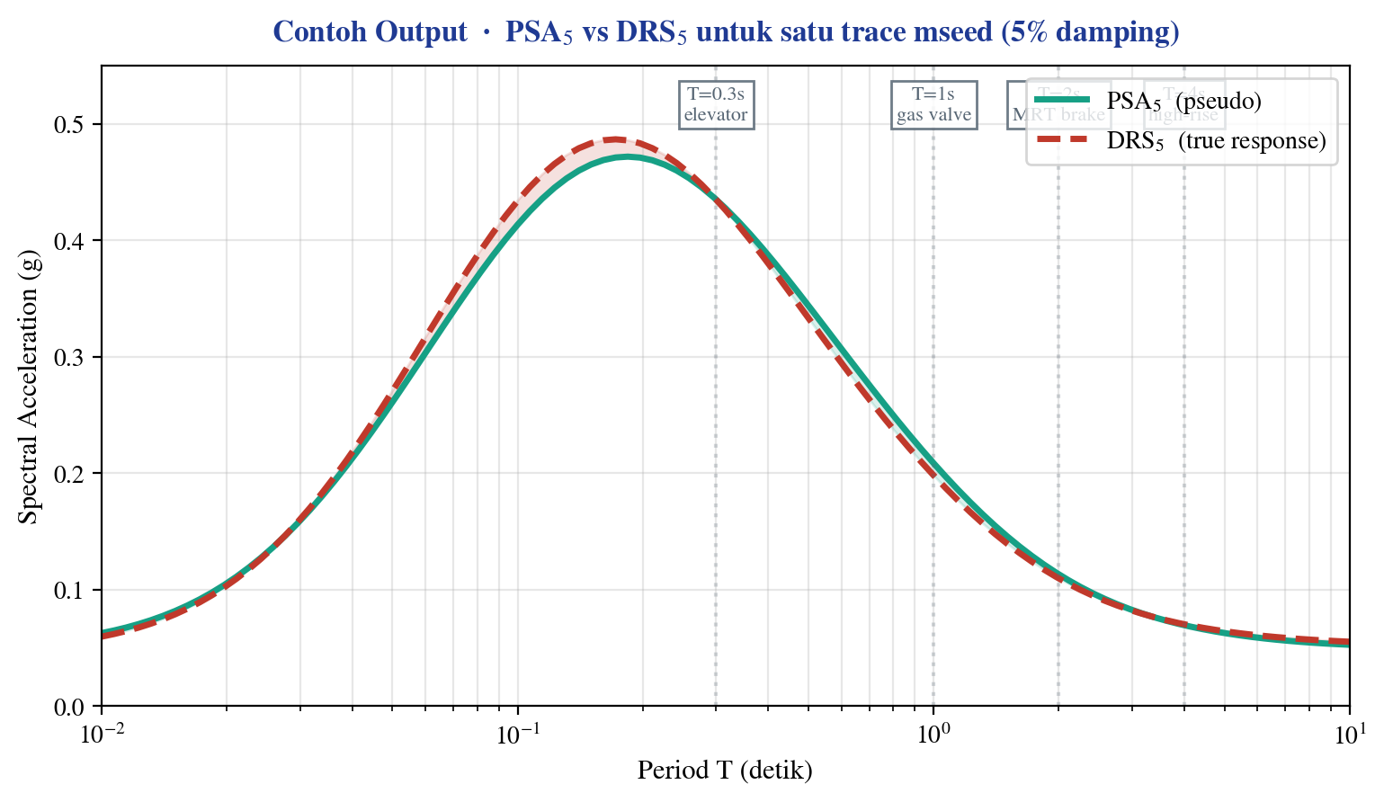
PROSES PEMBENTUKAN .psa5 & .drs5 · Pasca-Pengolahan mseed via modul scwfparams (SeisComP3)
5-stage pipeline · 5% damping
1
INPUT
2
PREPROCESSING
3
DECONVOLUTION
4
SDOF OSCILLATOR
5
OUTPUT
Data Akuisisi
Window & Conditioning
Counts → Physical Units
Response Computation
PSA5 + DRS5 Files
• .mseed continuous waveform
• QuakeML (event origin)
• Inventory (instrument response)
• Cut window berdasarkan travel-time
• Demean + cosine taper 5%
• High-pass filter ≥ 0,02 Hz
• Hapus instrument response
• Pole-zero deconvolution
• counts → m/s² (acceleration)
• Solve ODE single-DoF
• ζ = 0,05 (5% damping)
• 103 periode T ∈ [0,01–10] s
• EVENTID.STA.psa5 (pseudo SA)
• EVENTID.STA.drs5 (true SA)
• Plus PGA, PGV, CAV, IA
◆ INTI MATEMATIS — SDOF OSCILLATOR
◆ CONTOH OUTPUT — SPEKTRUM PSA5 vs DRS5
◆ HILIR — KEMANA FILE .psa5 & .drs5 DIPAKAI?
ShakeMap
Generate intensity contours
untuk emergency response
GMPE Calibration
Training set untuk model
Atkinson-Boore, ASK14, dst.
EEWS Dataset
103-period spectral target
untuk IDA-PTW Stage 2/3
Engineering Use
Direct input untuk fragility
curves & seismic design
Modul scwfparams · GFZ-Potsdam SeisComP3 · Konfigurasi: bindings/scwfparams/network.station · Output XML schema: SC3ML 0.10+
Hanif A. Nugraha · FMIPA UI · BMKG

