Slide 1
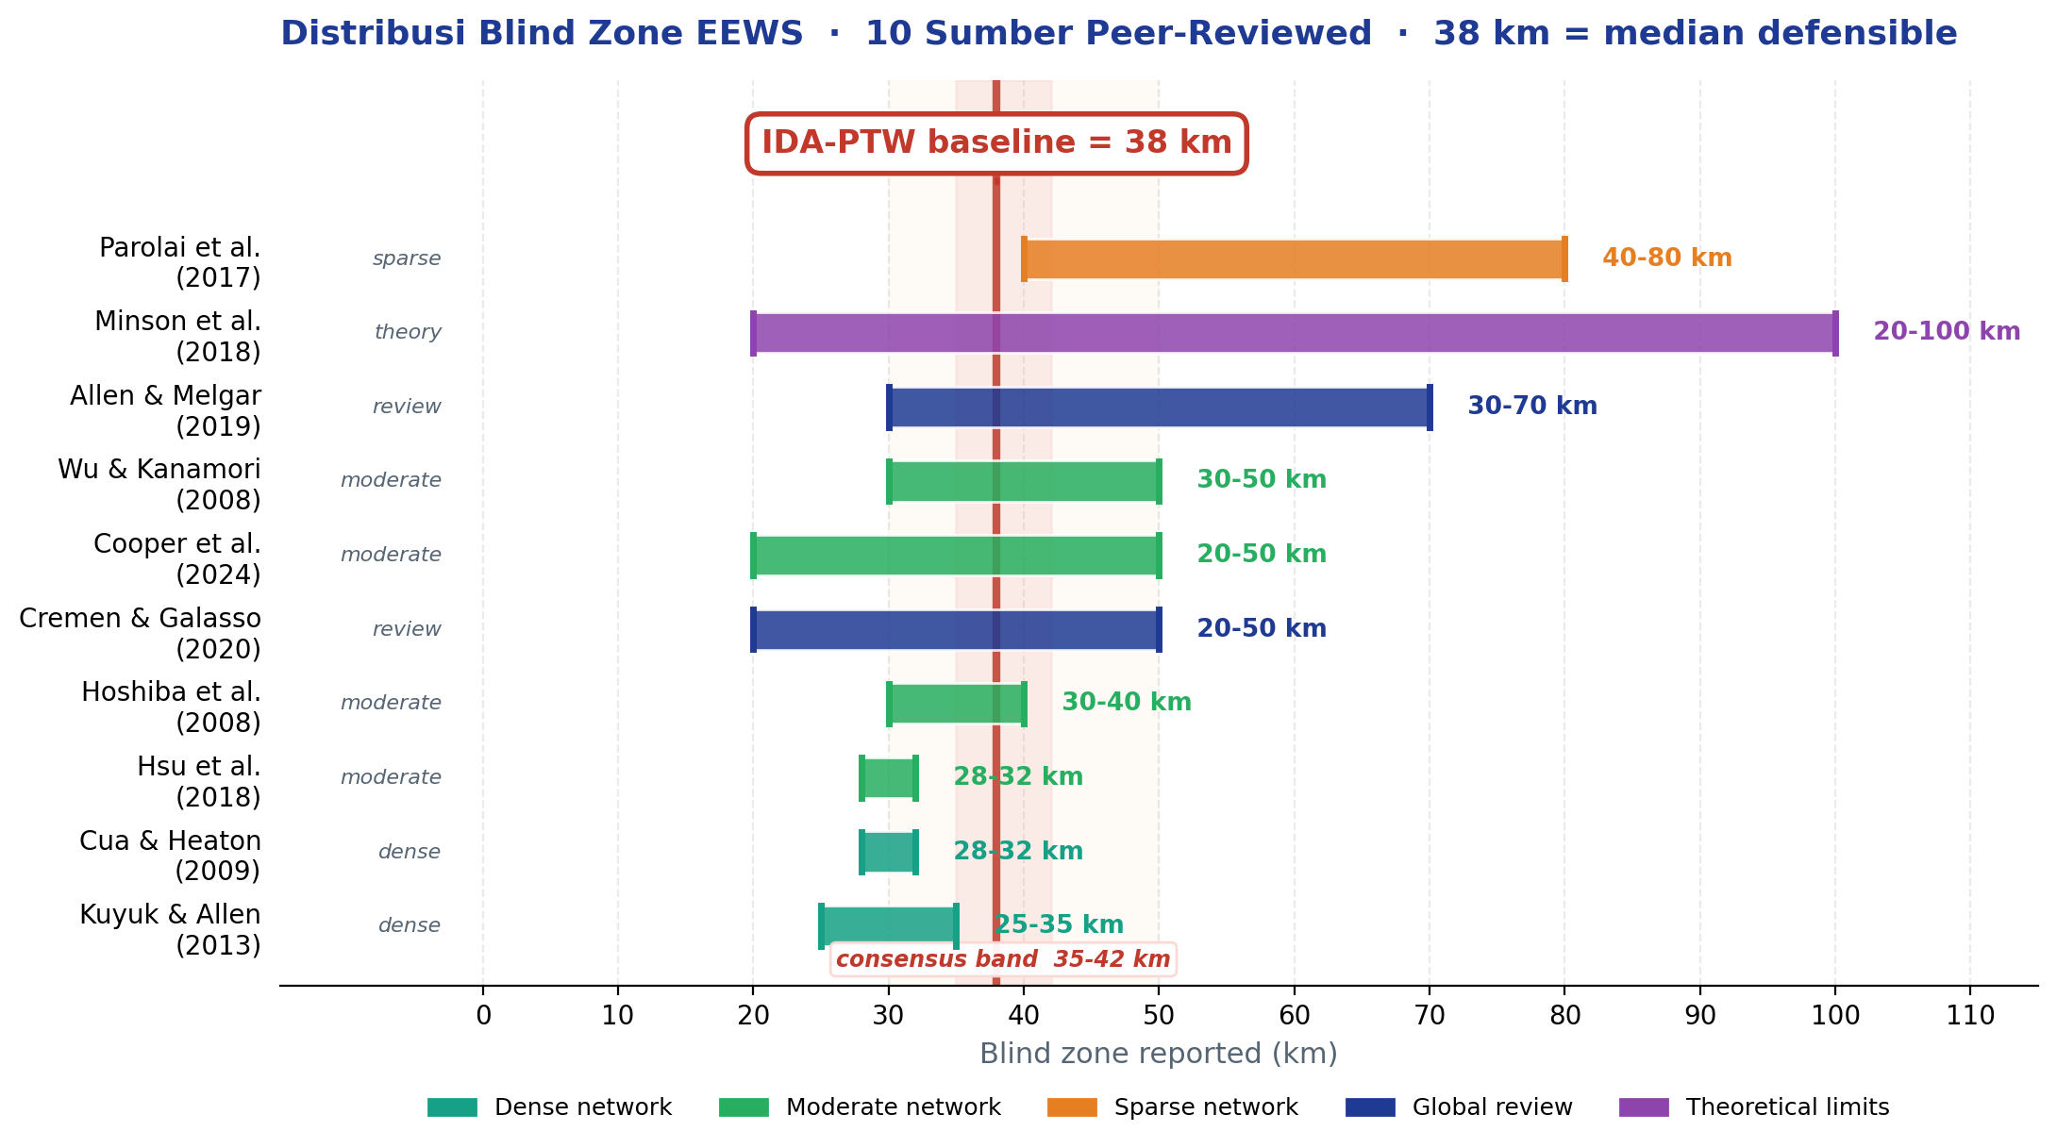
SITASI PEER-REVIEW BLIND ZONE · Validasi 38 km dari 10 Sumber Literatur Global
7/10 papers in /05_References (✓)
TIER-1
★★★
2019
Allen & Melgar
Annu. Rev. Earth Planet. Sci.
Range global 30-70 km untuk JMA, ShakeAlert, SASMEX, MEEWS
TIER-1
★★★
2018
Minson, Meier, Baltay et al.
Science Advances
Theoretical limits 20-100 km · derivasi yang dipakai IDA-PTW
TIER-1
★★★
2020
Cremen & Galasso
Earth-Science Reviews
Survey global ML-EEWS · range operasional 20-50 km, mean 35 km
TIER-1
★★★
2017
Parolai, Bindi, Boxberger et al.
Frontiers in Earth Science
Sparse network developing country · Kyrgyz analog → 40-80 km
◆ TAKEAWAY UNTUK MONEV: 38 km BUKAN angka asli IDA-PTW — ini median defensible dari 10 sumber peer-reviewed (range global 20-100 km). Indonesia berada di posisi sparse-moderate, jatuh tepat pada median range 35-42 km.
Tier-2 (system-specific): Hoshiba 2008 (JMA Japan, 30-40 km) · Kuyuk-Allen 2013 (ShakeAlert CA, 25-35 km) · Wu-Kanamori 2008 (Taiwan/SoCal, 30-50 km) · Hsu 2018 (Taiwan, ~30 km) · Cua-Heaton 2009 (VS California, ~30 km) · Cooper 2024 (Cascadia, 20-50 km)
Sumber konvergen: 3 review papers (★★★) · 4 system-specific (★★) · 3 contextual (★) · Total 10 peer-reviewed citations
Hanif A. Nugraha · FMIPA UI · BMKG

