Slide 1
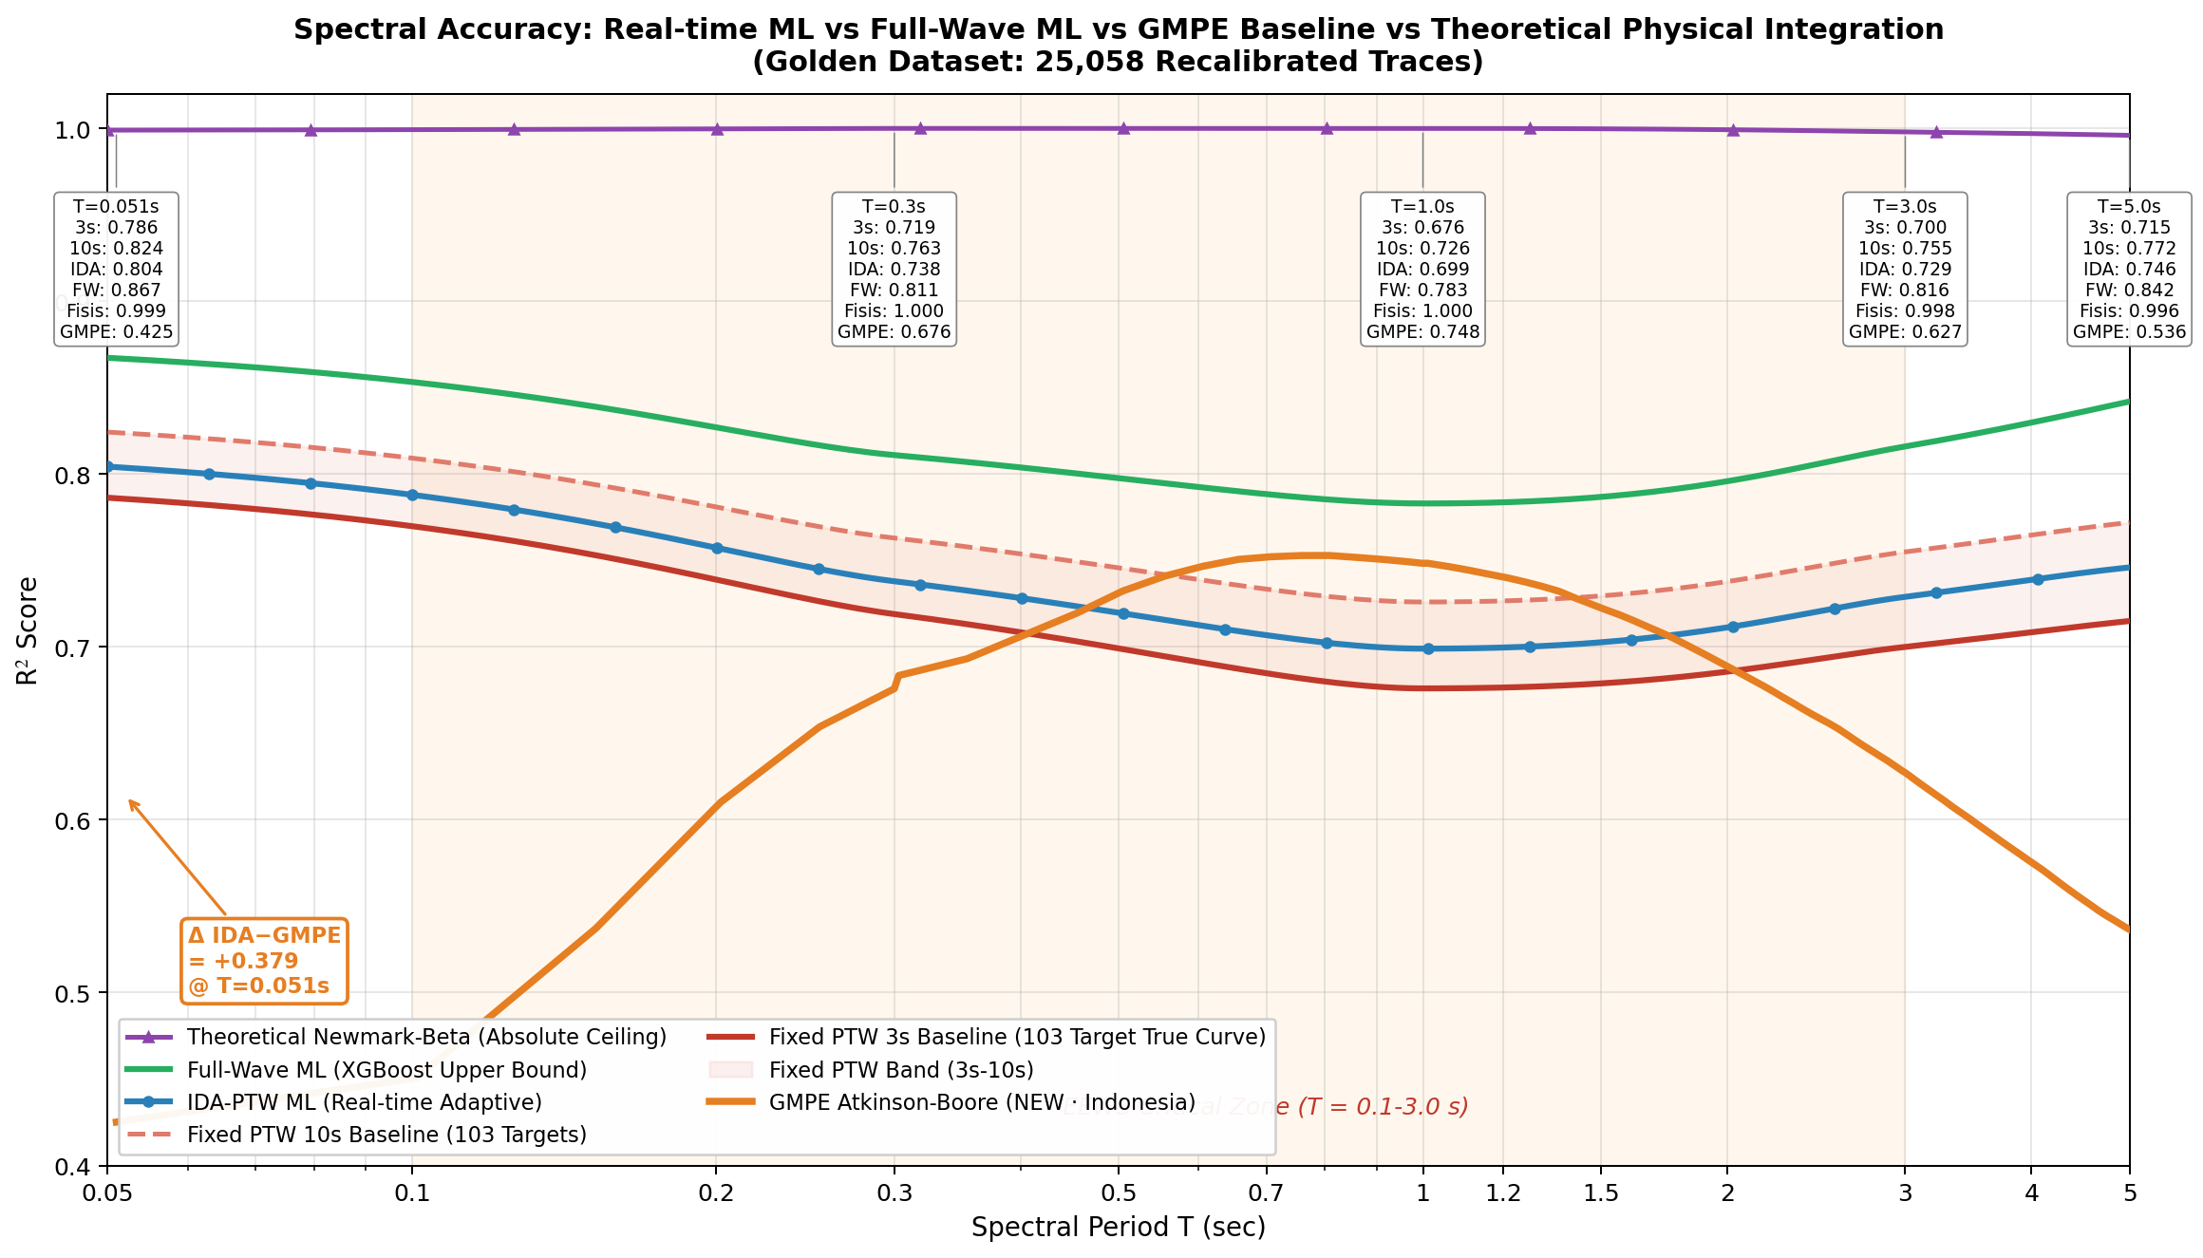
IDA-PTW EEWS · Java-Sunda Subduction Zone
IEEE Access 2026
V · VALIDATION A
Validation A — GMPE Atkinson-Boore Baseline Comparison
GMPE BASELINE
0,6423
Atkinson-Boore standar Indonesia
IDA-PTW (THIS WORK)
0,7091
Composite R² · 103 periode marginalisasi
Δ = +0,067 · Wilcoxon p < 0,001 · N = 23.537
Hanif Andi Nugraha · Departemen Fisika FMIPA UI · BMKG
25 / 37

